Slide 1

REMOTE PATIENT MONITORING SYSTEM
Team Members:
LETHIKA R
MADHUMITHA A

Slide 2
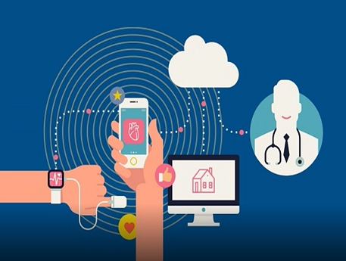
CONTENT
Abstract
Objective
Methodology
Block Diagram
Result and proof of concept
Conclusion

Slide 3
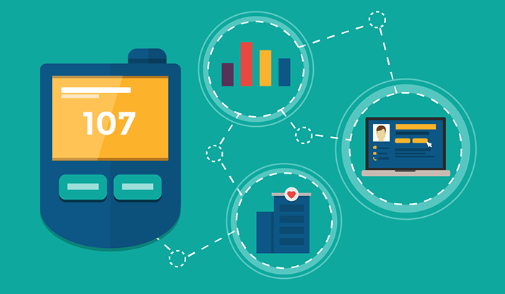
ABSTRACT
The majority of hospital expense go toward medical diagnostic.technology allows for the relocation of hospital centric medical check up routines to the patient home ( home-centric)
A proper diagnosis will also reduce the need for hospitalization since most people cannot visit hospitals for routine checkups, it is difficult to keep track of our health.
in remote areas under critical conditions, it is challenging for a doctor to keep an eye on the patient. We created an internet of things (IOT) approach that regularly monitors patient’s real time Health conditions.

Slide 4
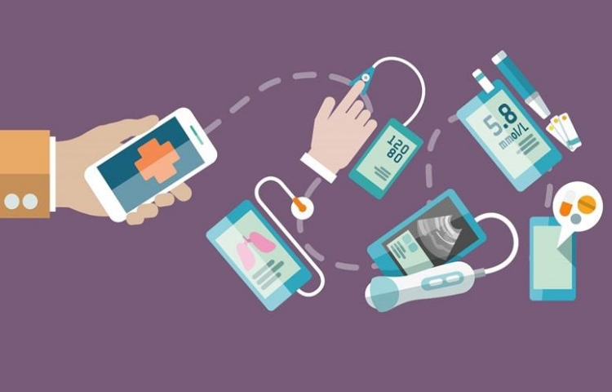
OBJECTIVE
A remote patient monitoring system is one of the solutions to overcome the barriers of health service.
It provides professional health care services to the rural population through IOT (internet of things)
Remote patient monitoring system allows the doctor to observe the patient’s health condition remotely at any time and any place The prevention can be done during the early detection of the disorder.
This paper proposes an IoT based real-time Human health monitoring system that able to support both real-time and store-and-forward modes.

Slide 5
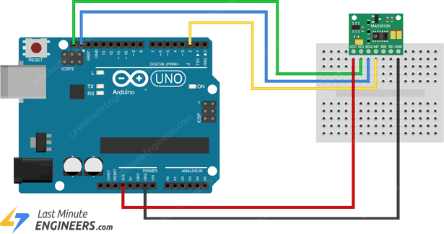
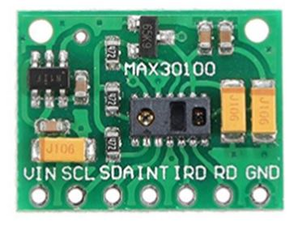
SENSORS USED
SPO2 SENSOR:
The MAX30100 is an integrated pulse oximetry and heart- rate monitor sensor solution.
It combines two LEDs, a photodetector, optimized optics, and low-noise analog signal processing to detect pulse oximetry and heart-rate signals.

Slide 6
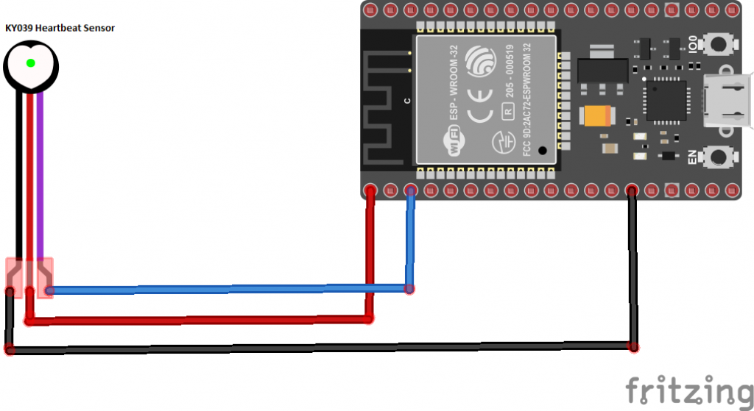
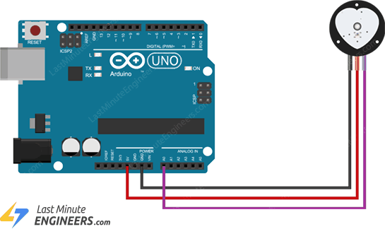
SENSORS USED
PULSE SENSOR:
The Pulse Sensor is a plug-and-play heart-rate sensor for Arduino.
The essence is an integrated optical amplifying circuit and noise eliminating circuit sensor.

Slide 7
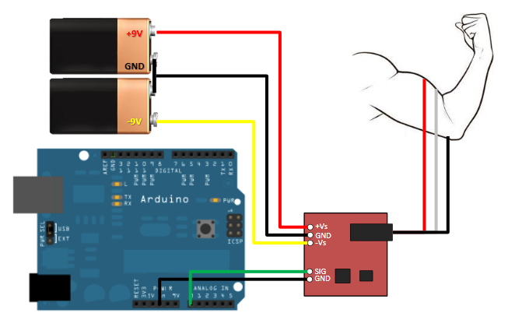
SENSORS USED
EMG SENSOR:
EMG Sensor, also known as electromyography sensor is one that measures small electrical signals generated by your muscles when you move them!
This includes lifting your arm up, clenching your fist, or even the simplest of movements like moving a finger.

Slide 8
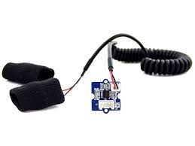
SENSORS USED
GALVANIC SKIN RESPONSE SENSOR:
GSR is a method of measuring the electrical conductance of the skin. Strong emotion can cause stimulus to your sympathetic nervous system, resulting more sweat being secreted by the sweat glands.
GSR allows you to spot such strong emotions by simple attaching two electrodes to two fingers on one hand.

Slide 9
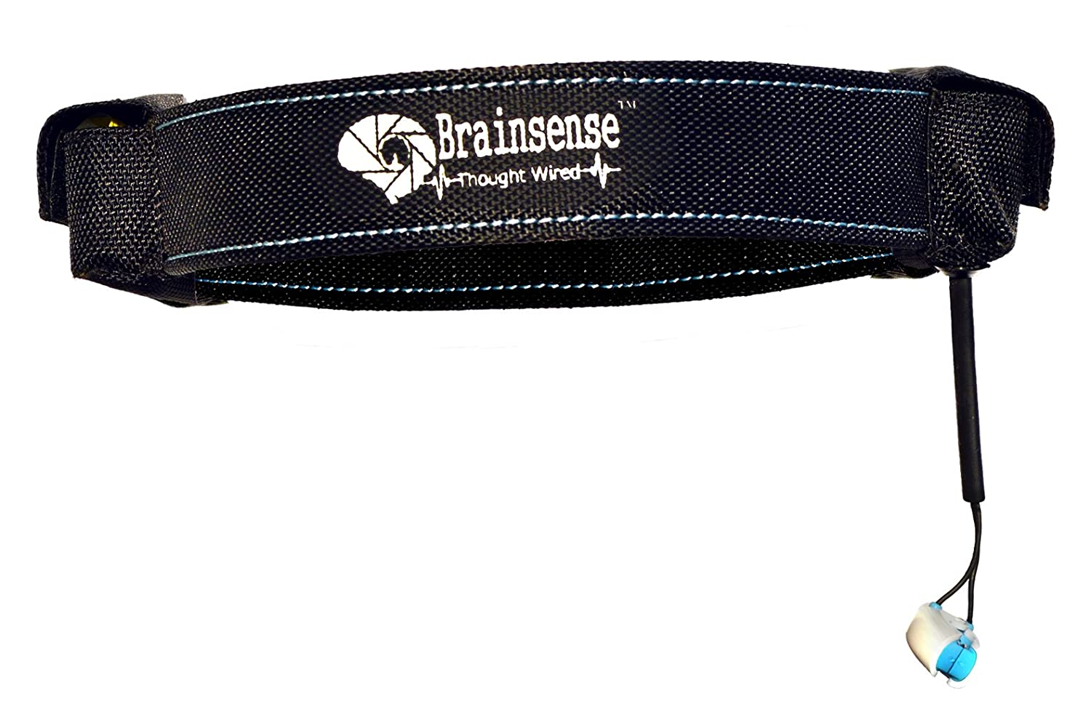
SENSORS USED
EEG SENSOR:
EEG Band measures your brainwaves and translates it into meaningful data to help you make the most of your cognitive performance.
The Brainwear can measure, track and help you improve your Attention, Focus, Meditation, Eye blink , and reduce Stress levels.

Slide 10
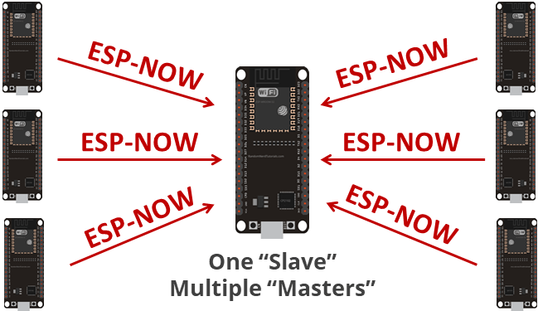
METHODOLOGY
ESP8266 node which is equipped with Wi-Fi is used as the main controller. All the data are processed via respective nodes and is sent to main controller using ESP-NOW protocol.
The collected real-time data will be processed by the main controller and then transmitted to web server via Wi-Fi module
This allows the proposed system to display the real-time ECG, EMG, EEG signal on the webserver and stores it in a database simultaneously.
The Data is Analysed using machine learning algorithms and the analysed data is sent to patient as a Report.
The doctor also can view the real-time ECG signal via Android mobile application (App).
The App can display heartbeat rate (BPM), Oxygen saturation (SPO2), Pulse, Muscle health, Brain Wave Pattern and a real-time chart. The Data is extracted from the received real-time data, it updates every 10 seconds

Slide 11
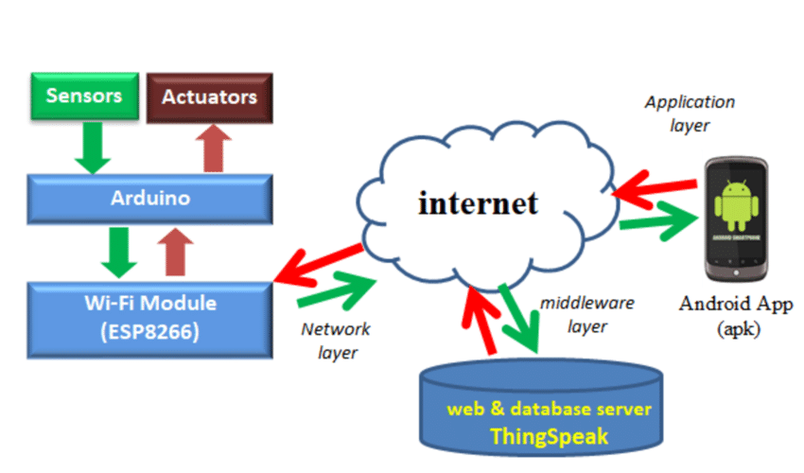
BLOCK DIAGRAM
ESP8266 NODE MCU

Slide 12
RESULT AND PROOF OF CONCEPT
WORKING MODEL
https://drive.google.com/file/d/1-BHhWTGQwpGXd-8q6Bpzdqh39GbhgMR3/view?usp=drivesdk

Slide 13

CONCLUSION
The developed real-time patient monitoring system has been tested in both private and public networks. The real-time ECG, EMG, and EEG signal was displayed on the web and stored in the cloud server successfully.
The proposed system can be applied in the hospital. The doctors or nurses can observe the signal of any patient at any time any place through the computer or smartphone, without going to the wards.
This system is able to reduce the patients traveling time and cost especially for those patients who are from suburban or rural areas.
The proposed system has the potential of improving the quality of healthcare services all over the nation.
In future, These sensor data can be self-interpretation algorithm can be implemented into the system so that the system can detect the abnormal Parameter signal and generate an alert.system also can be expanded by adding more e-health sensors to collect various health parameters.

Slide 14

THANK YOU

